Slide 1

Repeatable Infrastructure With Azure
Cory Hall

Slide 2



Sponsors
Gold
Special Thanks
Gold

Slide 3
A Little About Me
I am an DevOps Engineer on the M365 Operations Teams
My areas of ownership are infrastructure, security and deployments for two globally distributed systems used by M365 support agents
My current infatuations are robotics and Golang

Slide 4
Why would anyone want to repeat their infrastructure?
To reliably build out microservices
To create ephemeral environments for testing or experimentation
To facilitate disaster recovery
To build new stamps in new regions or update existing stamps

Slide 5
What Is A Service Stamp?
A service stamp is a set of resources that make up a “micro service”. Typically, stamps are represented without scale but contain load balancing.

Slide 6
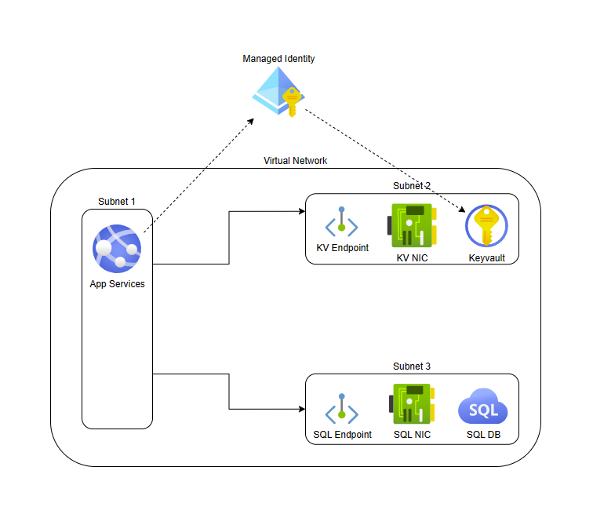
What Does My Service Stamp Look Like?
Source code: https://github.com/blockdalegend/ATLCloudConferenceDemo

Slide 7
Three Phases of Repeatable Infrastructure
Phase 1
Can I build my stamp?
Phase 2
Can I build a new stamp?
Phase 3
Can I build a new stamp and update my old stamp at the same time?

Slide 8
Thank You For Coming!

